Slide 2
DevOps Dashboards featuring DIY DevOps Dashboard
Alexander Stevenson, Developer Advocate @alexstev_dev
DEVNET-1704
DEVNET-1704

Slide 3

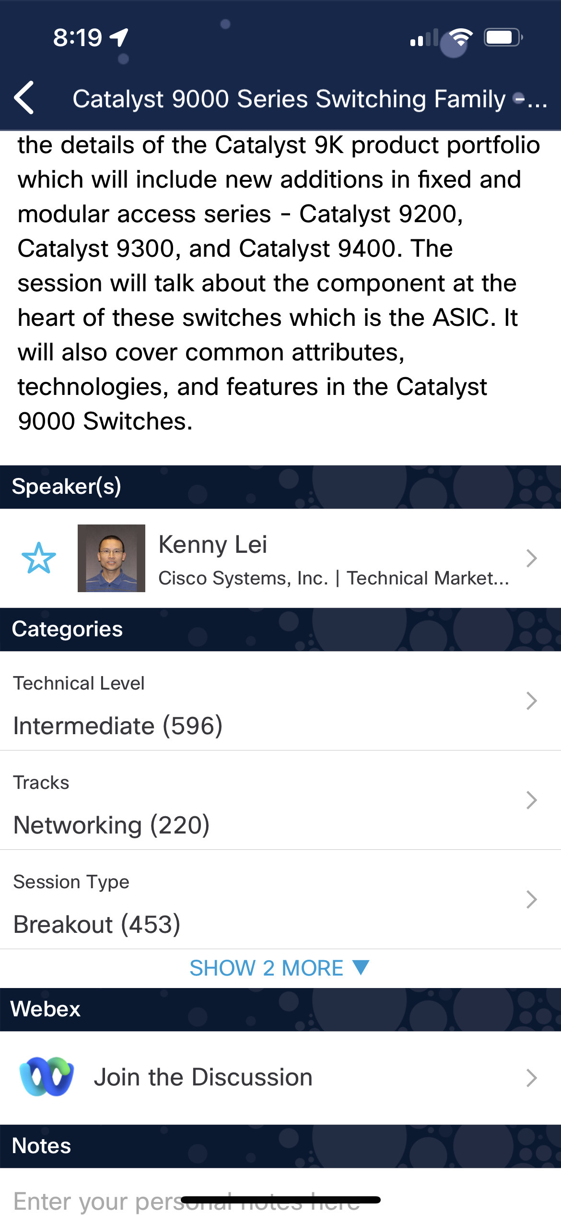
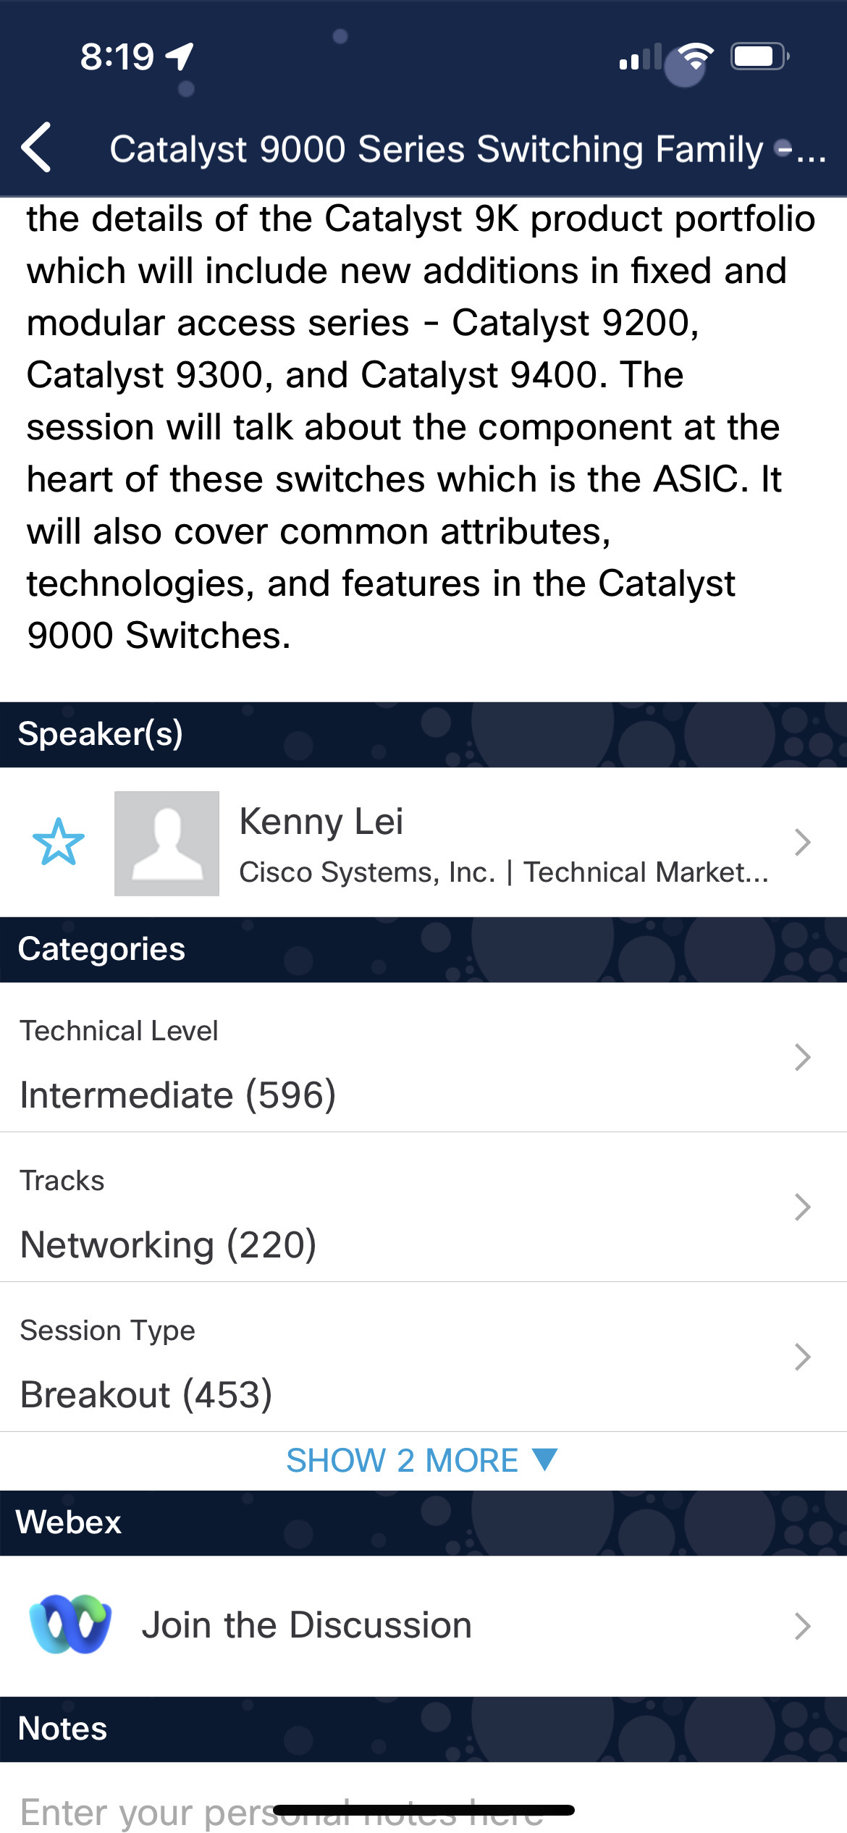

Cisco Webex App
Questions? Use Cisco Webex App to chat with the speaker after the session
How
1
Find this session in the Cisco Live Mobile App
Click “Join the Discussion”
Install the Webex App or go directly to the Webex space
Enter messages/questions in the Webex space
2
3
Enter your personal notes here
4
Webex spaces will be moderated by the speaker until February 23, 2024.
https://ciscolive.ciscoevents.com/ciscolivebot/#BRKXXX-xxxx
© 2023 Cisco and/or its affiliates. All rights reserved. Cisco Public
3

Slide 4
Introduction

Slide 5
Speaker
Alexander Stevenson
Developer Advocate and DevNet Engineer at Cisco DevNet
A Cisco Code Exchange, Cisco Blogs, and Cisco Community published author
Co-creator and lead content developer of the ‘DevOps Shop’ video series
Certifications: DevNet Specialist – DevOps, DevNet Associate, and Cisco Certified Cyber Ops Associate

Slide 6

Speaker (continued)
Alexander Stevenson
Four years at Cisco, previously a software engineer at Apple
Earned M.Ed, B.Sc. in Network Systems, and Diploma in Full-Stack Software Engineering
Combat veteran
Proud cat custodian

Slide 7
Overview of DevOps Dashboards:
Key Components
Functionality
5 Popular DevOps Dashboards:
Main features
Advantages
Disadvantages

Slide 8
Choosing a Dashboard:
Key Takeaways and Considerations
DIY DevOps Dashboard:
What it does
How it works
(continued)

Slide 9
Which of the following 5 quotes about DevOps Dashboards is true?

Slide 10
1. “DevOps dashboards bring visibility and accountability, making it easy to monitor the entire software development process.” 2. “A well-built DevOps dashboard is a window into the efficiency of your development and operations teams.” 3. “DevOps dashboards enable teams to track, analyze and optimize the performance of software delivery.” 4. “The power of a DevOps dashboard lies in its ability to provide a holistic view of the software delivery process.” 5. “DevOps dashboards, when properly utilized, can be the driving force behind the continuous improvement of the software development lifecycle.”

Slide 11
The answer is….
they are all correct!

Slide 12
Overview of DevOps Dashboards

Slide 13
DevOps Dashboards: Definition & Purpose
Visual interfaces that provide real-time insights and metrics on the health, performance, and progress of dev and operations processes.
Consolidate and present data from various sources, such as monitoring tools, build systems, version control systems, and more.
Provide a centralized and easily accessible view of critical information, enabling teams to quickly identify issues, track progress, and make informed decisions.
Improve efficiency, productivity, and overall software quality by enabling teams to monitor key metrics, identify bottlenecks, and take proactive actions to address them.

Slide 14
Key components and functionalities of DevOps Dashboards
Data Aggregation / Normalization
Visualization
Metrics and Key Performance Indicators
Alerting and Notifications
Customizability
Collaboration Features
Historical Data Analysis
Integration Capabilities

Slide 15
Popular DevOps Dashboards

Slide 16
Grafana
Main Features
1. Data Source Integration
2. Customizable Visualizations
3. Dashboard Templating
4. Alerting and Notifications

Slide 17
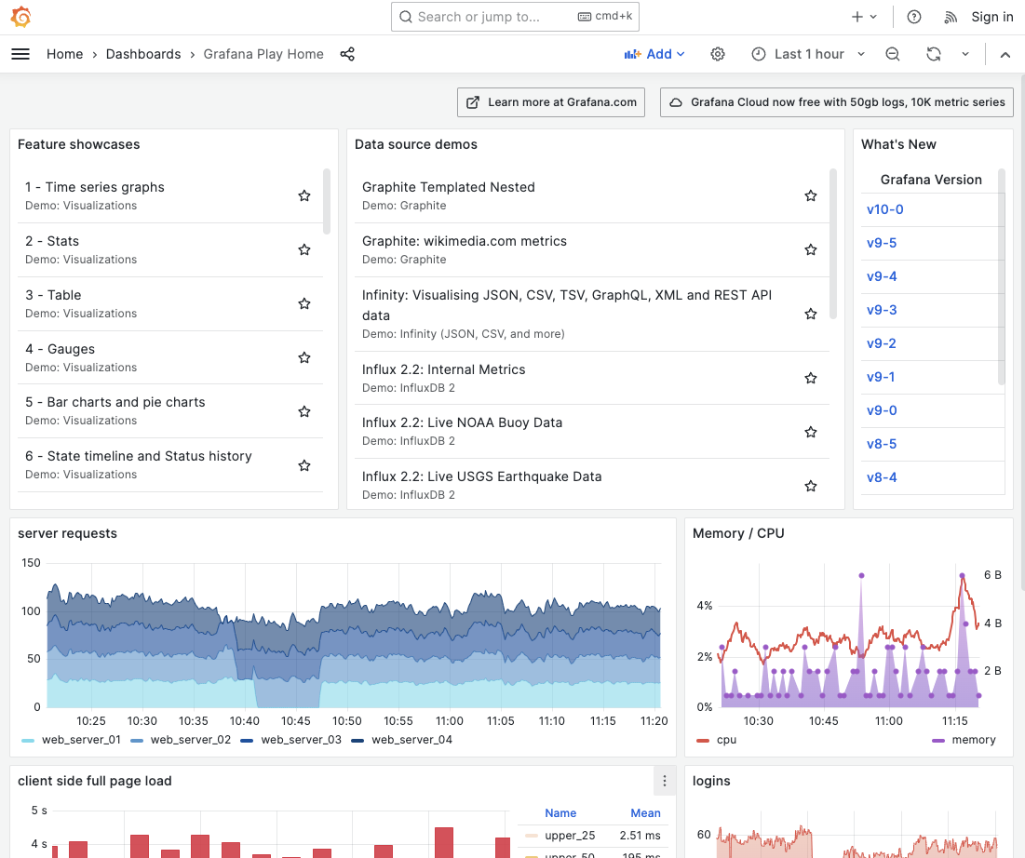
Grafana
Demo
https://play.grafana.org/

Slide 18
Grafana
Advantages
1. User-friendly Interfaces
2. Wide Community Support
3. Extensibility

Slide 19
Grafana
Disadvantages
1. Steep Learning Curve for Advanced Features
2. Resource Intensive
3. Lack of Native Time Series Database

Slide 20
Grafana
Summary
Overall, Grafana's extensive features, user-friendly interface, and strong community support make it a popular choice for creating powerful and customizable DevOps Dashboards. However, users should be aware of the potential learning curve for advanced features and the resource requirements when deploying Grafana.

Slide 21
Prometheus
Prometheus is an application that is used to actively gather statistics and trigger alerts from the running virtual machines and application services. Internally, the Prometheus servers scrape statistics from target statistics sources on a regular basis.
In addition to scrapping, statistics in the Prometheus servers can be configured using the Management CLI alert rule command to trigger alerts on error conditions.

Slide 22
Prometheus
Main Features
1. Time Series Data Collection
2. Flexible Query Language (PromQL)
3. Alerting and Monitoring Rules
4. Service Discovery and Auto-Targeting

Slide 23
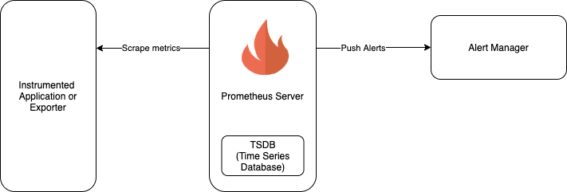
Prometheus

Slide 24
Prometheus
The expression browser is available at /graph on the Prometheus server, allowing you to enter any expression and see its result either in a table or graphed over time. This is primarily useful for ad-hoc queries and debugging. For graphs, use Grafana or Console templates.
In the context of feeding data to Grafana, Prometheus serves as both a database (as it stores the time-series data that Grafana will visualize) and an aggregator (as it pulls in metrics from various sources). Grafana queries Prometheus for this collected data and then visualizes it on the dashboard.

Slide 25
Prometheus
Prometheus mainly serves two major functionalities:
Metrics Collection and Storage: Prometheus collects metrics from configured targets at given intervals, evaluates rule expressions, displays the results, and can trigger alerts if some condition is observed to be true. In this capacity, it acts as a time-series database storing all the collected metrics data.
Data Exporter/Aggregator: Prometheus also acts as an aggregator, gathering metrics from various targets like applications, systems, or other services. It does this through a pull model, where Prometheus scrapes metrics from instrumented jobs, either directly or via an intermediary push gateway for short-lived jobs.

Slide 26
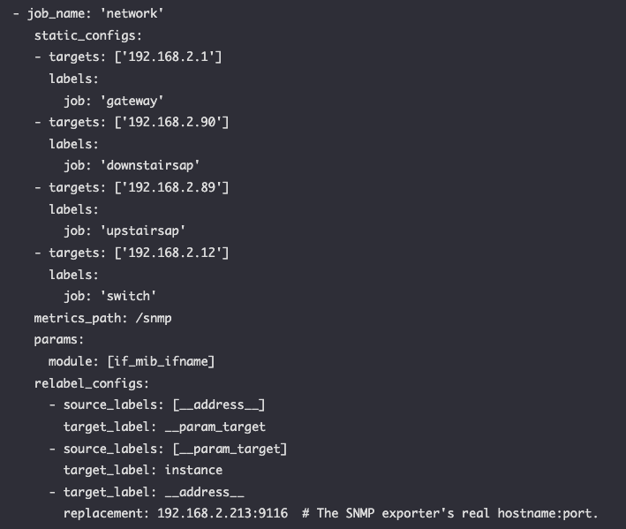
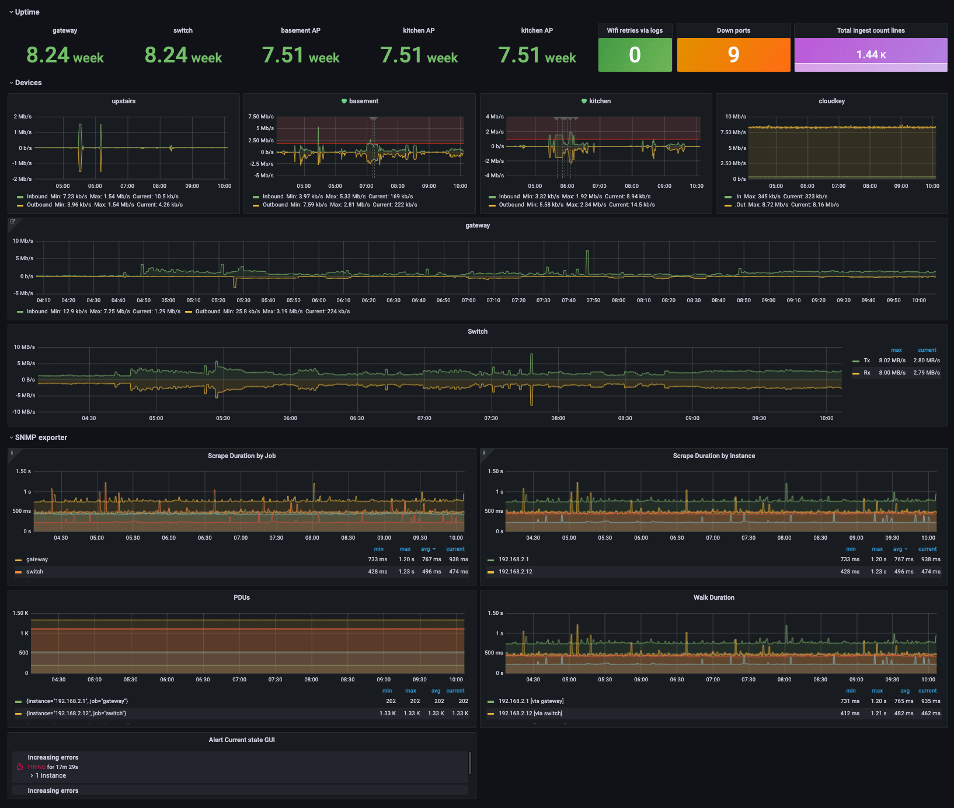
Prometheus
Networking monitoring with snmp_exporter, Prometheus, and Grafana
prometheus.yml
Prometheus works hand-in-hand with Grafana

Slide 27
Prometheus
Advantages
1. Powerful Monitoring Capabilities
2. Scalability and Reliability
3. Active Community and Ecosystem

Slide 28
Prometheus
Disadvantages
1. Storage and Retention
2. Lack of Advanced Visualization

Slide 29
Prometheus
Summary
Prometheus is often used as a data source for Grafana, as Grafana provides a more advanced and flexible visualization layer on top of Prometheus. Together, Prometheus and Grafana form a powerful combination for monitoring, analyzing, and visualizing metrics.

Slide 30
Datadog
Main Features
1. Comprehensive Monitoring
2. Real-time Visualization
3. Alerting and Collaboration

Slide 31
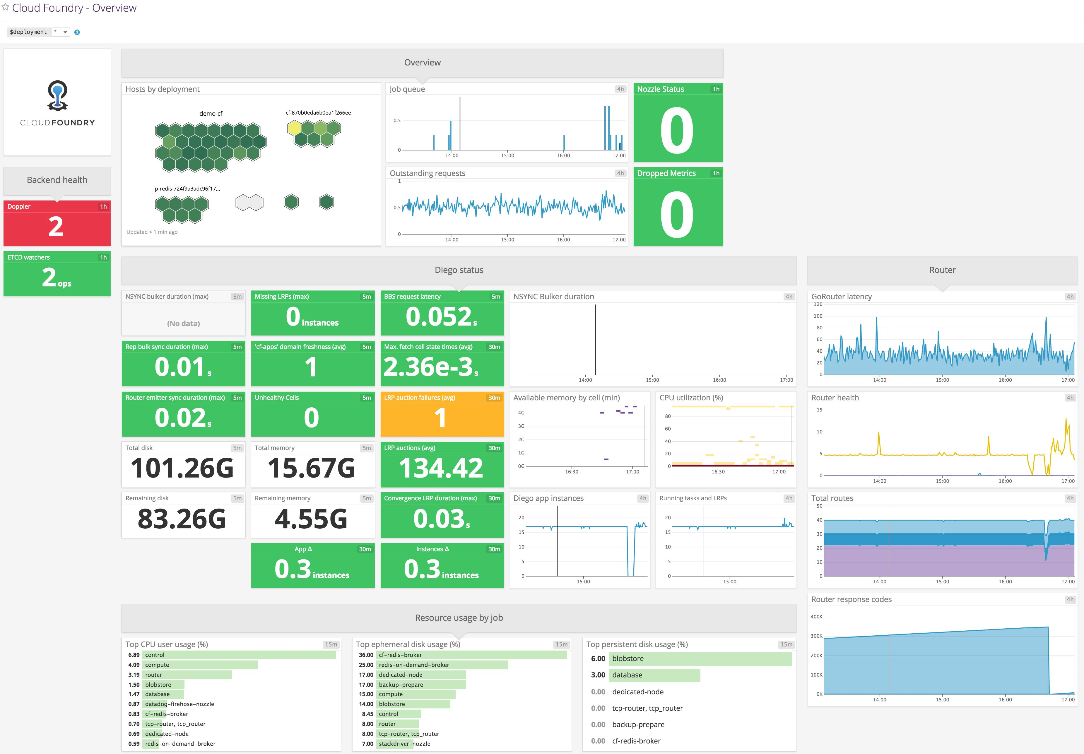
Datadog

Slide 32
Datadog
Advantages
1. Ease of Use
2. Rich Integrations
3. Comprehensive Monitoring Capabilities

Slide 33
Datadog
Disadvantages
1. Cost
2. Learning Curve for Advanced Features
3. Cloud Dependency

Slide 34
Datadog
Summary
Datadog's comprehensive monitoring capabilities, ease of use, and rich integrations make it a popular choice for creating DevOps Dashboards. However, organizations should consider the cost implications and evaluate the learning curve for advanced features when deciding to adopt Datadog as their monitoring and dashboarding solution.

Slide 35
Elastic Stack
4 Main Components
1. Elasticsearch
2. Logstash
3. Kibana
4. Beats

Slide 36
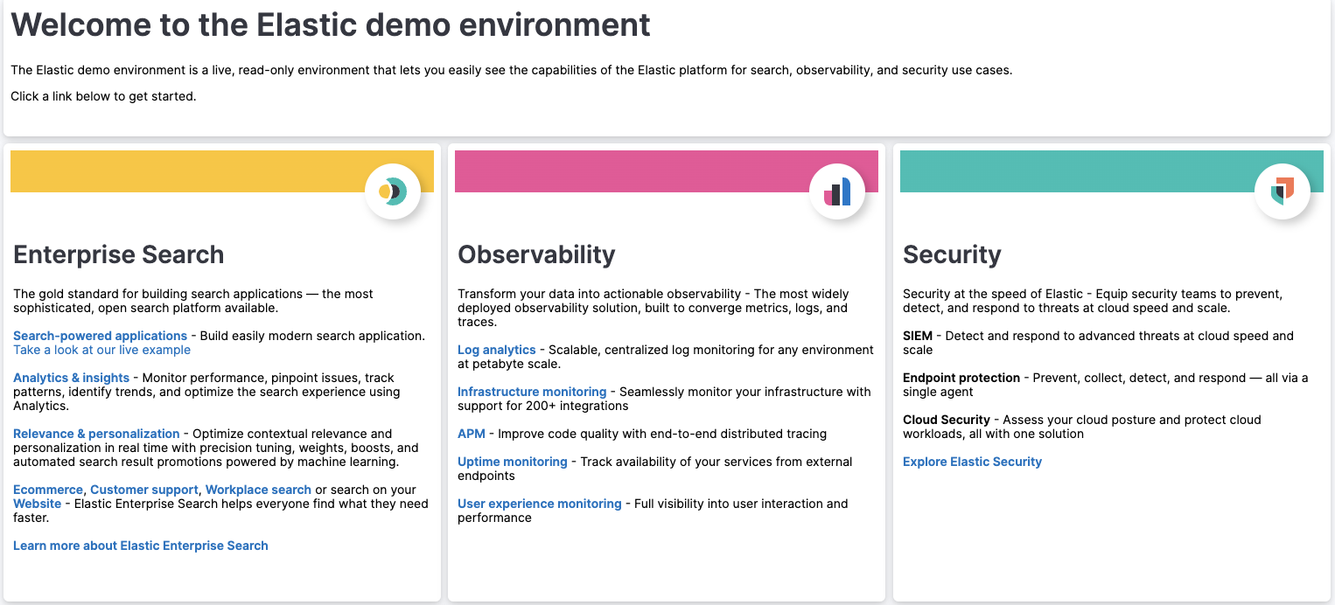
Elastic Stack
Elastic Demo Environment
https://demo.elastic.co/app/dashboards#/view/welcome_dashboard

Slide 37
Elastic Stack
Advantages
1. Scalability and Flexibility
2. Powerful Log Analysis
3. Open-Source and Active Community

Slide 38
Elastic Stack
Disadvantages
1. Complexity and Learning Curve
2. Resource Intensive
3. Maintenance and Monitoring

Slide 39
Elastic Stack
Summary
Elastic Stack's scalability, powerful log analysis capabilities, and active community support make it a popular choice for log management and analytics. However, organizations should be prepared for the initial complexity, resource requirements, and ongoing maintenance associated with deploying and managing the Elastic Stack.

Slide 40
New Relic
Main Features
1. Application Performance Monitoring
2. Infrastructure Monitoring
3. Real-User Monitoring
4. Synthetic Monitoring

Slide 41
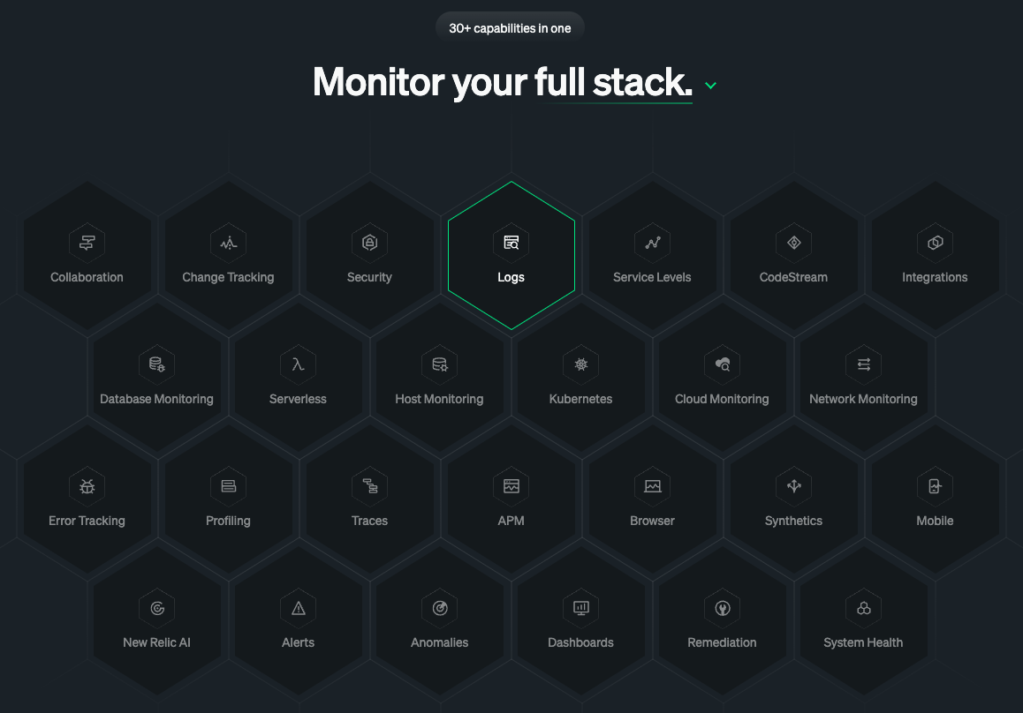
New Relic

Slide 42
New Relic
Advantages
1. All-in-One Observability Platform
2. Ease of Use
3. Analytics and Insights

Slide 43
New Relic
Disadvantages
1. Cost
2. Limited Customization
3. Dependency on External Infrastructure

Slide 44
New Relic
Demos
https://www.youtube.com/@NewRelicInc
https://newrelic.com/request-demo

Slide 45
New Relic
Summary
New Relic's all-in-one observability platform, ease of use, and analytics make it a popular choice for monitoring applications, infrastructure, and user experience. However, organizations should consider the cost implications and evaluate the level of customization required when choosing New Relic as their observability solution.

Slide 46

Key considerations for choosing a suitable DevOps Dashboard

Slide 47
Key considerations for choosing a suitable DevOps Dashboard
1. Identify your specific needs
2. Evaluate scalability and flexibility
3. Assess customization and extensibility
4. Consider learning curve and ease of use
5. Evaluate cost considerations
6. Consider community support and ecosystem

Slide 48
DIY DevOps Dashboard

Slide 49
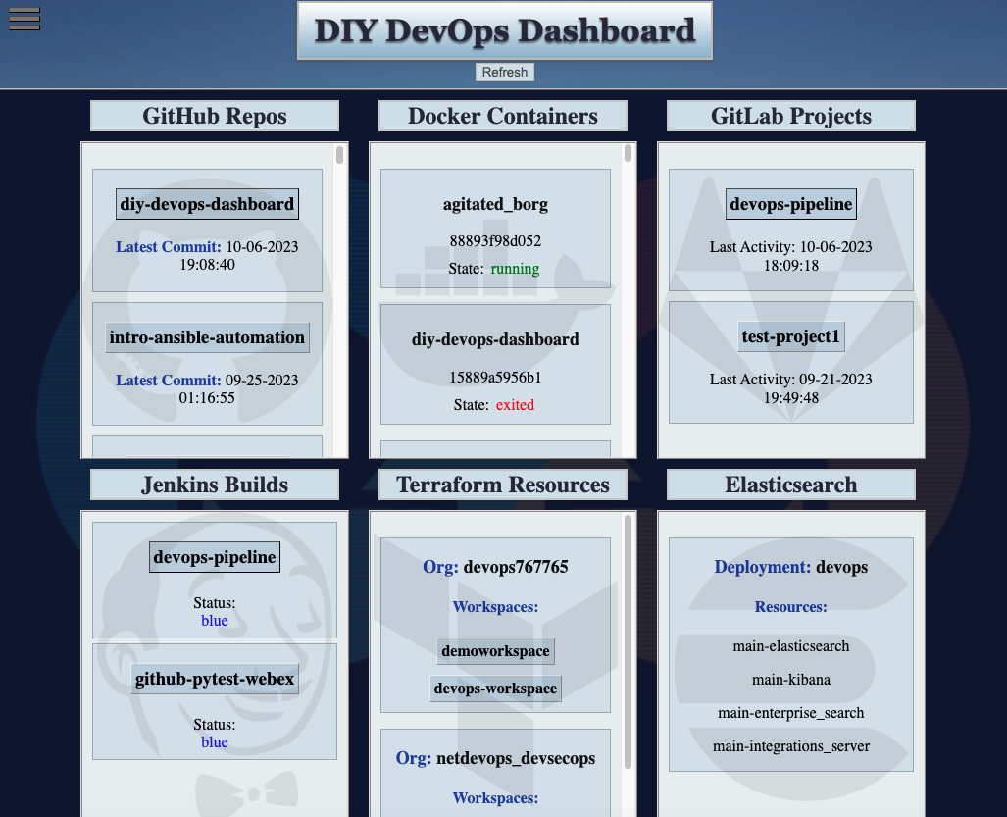
DIY DevOps Dashboard

Slide 50
Motivation for the Project
I made this project as a way for those new to DevOps to get started with the basic DevOps technologies involved. It requires setting up the basic accounts and then provides the user with an all-in-one place to see their progress and to better understand how these different tools interact in the DevOps lifecycle.

Slide 51
Description
This project runs a Flask App, which serves the web dashboard. It is written in Python and most of the data is collected via external API calls, with Docker and Jenkins data being collected straight from your machine.
Besides displaying all your DevOps data neatly organized in the dashboard, you can send the data to a Webex space via message by clicking the 'Post to Webex' button in the menu.

Slide 52
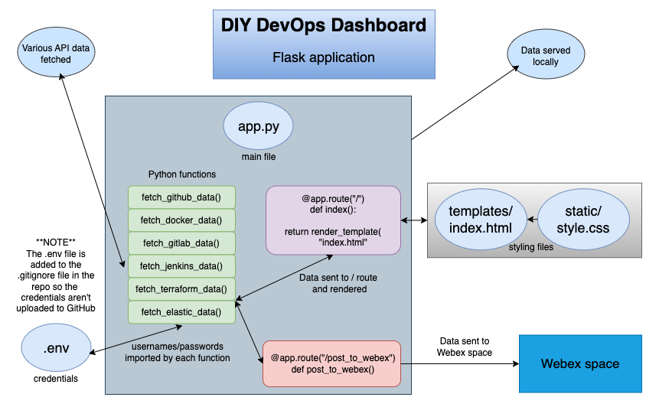
Flow Chart for the DIY DevOps Dashboard

Slide 53
Prerequisites
GitHub, GitLab, Terraform, and Elastic-Cloud accounts must be created and the credentials placed in the .env file in order for the data from those platforms to display properly in the dashboard. Jenkins projects and Docker containers will also need to be present locally, for that data to be populated in the dashboard.
- You will need Python installed, at least version 3.9.5
- Docker will need to be installed. I'm running Docker Desktop on Mac. The Docker Engine must be running for the dashboard to load.

Slide 54
Installation of the DIY DevOps Dashboard
1. Create a virtual environment locally and activate it.
2. Clone this repo and cd into it.
git clone https://github.com/xanderstevenson/diy-devops-dashboard.git
cd diy-devops-dashboard
3. Install the required dependencies
pip install -r requirements.txt

Slide 55
Installation of the DIY DevOps Dashboard(continued):
4. Make sure you have account set-up with GitHub, GitLab, Terraform, and Elastic Cloud
5. Create a file called .env in the same directory as app.py and place your credentials from those accounts into .env. The required credentials are listed in the .env-example file. Do not place any credentials in .env-example!
GITHUB_USERNAME="your_username"
GITHUB_ACCESS_TOKEN="your_access_token"
...
*** The .env file is listed in the .gitignore file, so .env will not be pushed to GitHub if you decide to fork this project. ***

Slide 56
Using the DIY DevOps Dashboard
1. Run the Flask app from the project root directory
python3 app.py or python app.py
2. Navigate to http://127.0.0.1:8000 or http://localhost:8000 to view the dashboard
3. To stop the container, type Ctrl + C one or twice in the virtual directory in which you ran the docker commands.

Slide 57
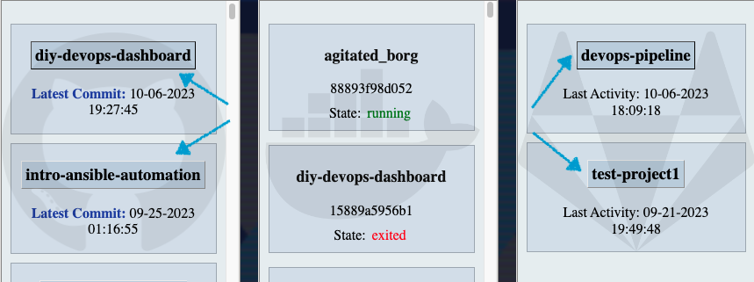
Functionality
Text within each section that is surrounded by a box is clickable and will take you to the web page for that resource.

Slide 58
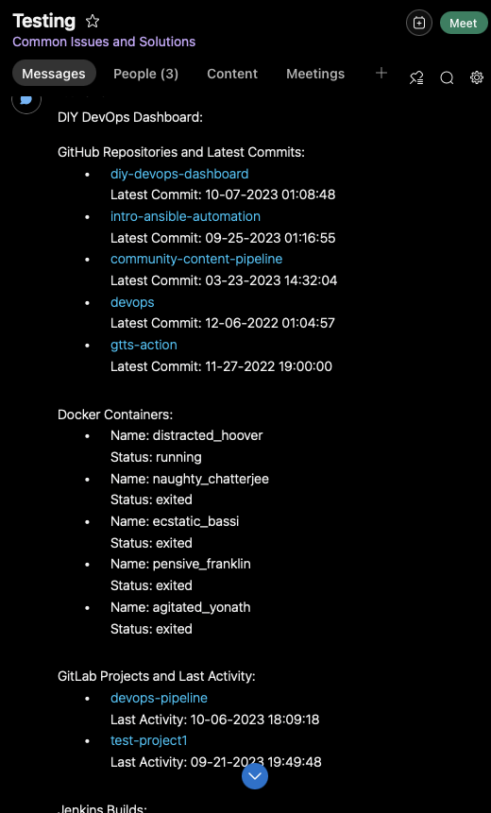
By clicking on the hamburger menu icon on the top left, you can view the button to 'Post to Webex’.
Push this once and it will send the data for this dashboard, truncated to five results per tool, to the Webex space indicated in the .env file. This will take up to 15 seconds. To make the button disappear, click on the hamburger menu icon again.

Slide 59

Functionality (continued)
The entire page will reload every 5 minutes, thanks to the JavaScript at the bottom of /templates/index.html. You can also refresh the page manually by clicking on the "Refresh" button.
More blocks for additional tools can be added to templates/index.html and additional functions would need to be added to app.py

Slide 60
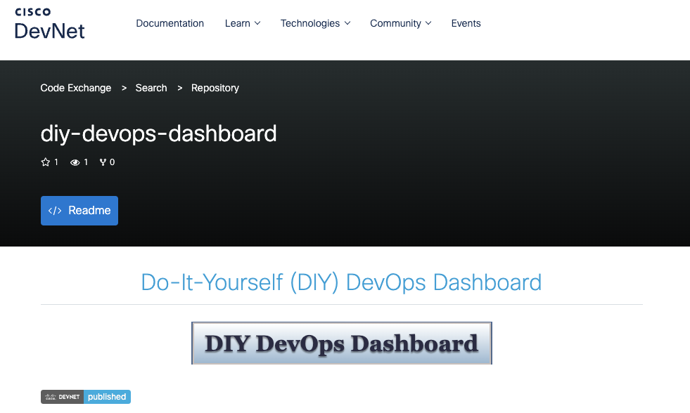
Be Sure to Check Out the DIY DevOps Dashboard on the Cisco Code Exchange
http://cs.co/diy-devops-dashboard

Slide 61
DevOps Shop series video: 'DevOps Dashboards featuring DIY DevOps Dashboard'

Slide 62
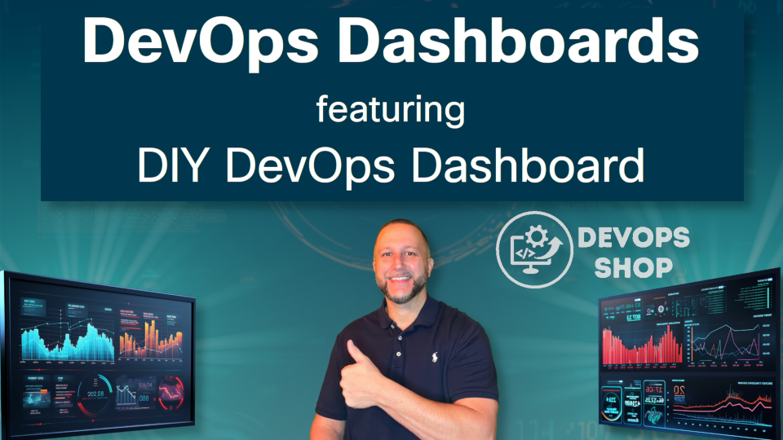
This video is essentially a truncated, video version of this session.
https://www.youtube.com/watch?v=fzBCqMisNcU

Slide 63
Summary
Key components and functionality of DevOps dashboards
Five popular DevOps Dashboards
Considerations when choosing a DevOps Dashboard
DIY DevOps Dashboard

Slide 64

Thank you!
#CiscoLiveAPJC
© 2022 Cisco and/or its affiliates. All rights reserved. Cisco Public

Slide 65


Fill out your session surveys!
Attendees who fill out a minimum of four session surveys and the overall event survey will get Cisco Live-branded t-shirt (while supplies last)!
All surveys can be taken in the Cisco Events Mobile App or by logging in to the Session Catalog and clicking the "Attendee Dashboard” at https://www.ciscolive.com/emea/learn/sessions/session-catalog.html

Slide 66
Cisco Webex App
Questions? Use Cisco Webex App to chat with the speaker after the session
How
1
Find this session in the Cisco Live Mobile App
Click “Join the Discussion”
Install the Webex App or go directly to the Webex space
Enter messages/questions in the Webex space
2
3
Enter your personal notes here
4
Webex spaces will be moderated by the speaker until February 23, 2024.
https://ciscolive.ciscoevents.com/ciscolivebot/#BRKXXX-xxxx
© 2023 Cisco and/or its affiliates. All rights reserved. Cisco Public
66

Slide 67

Continue Your Education
Visit the Cisco Showcase for related demos
Book your one-on-one Meet the Engineer meeting
Attend the interactive education with DevNet, Capture the Flag, and Walk-in Labs
Visit the On-Demand Library for more sessions at www.CiscoLive.com/on-demand

Slide 68
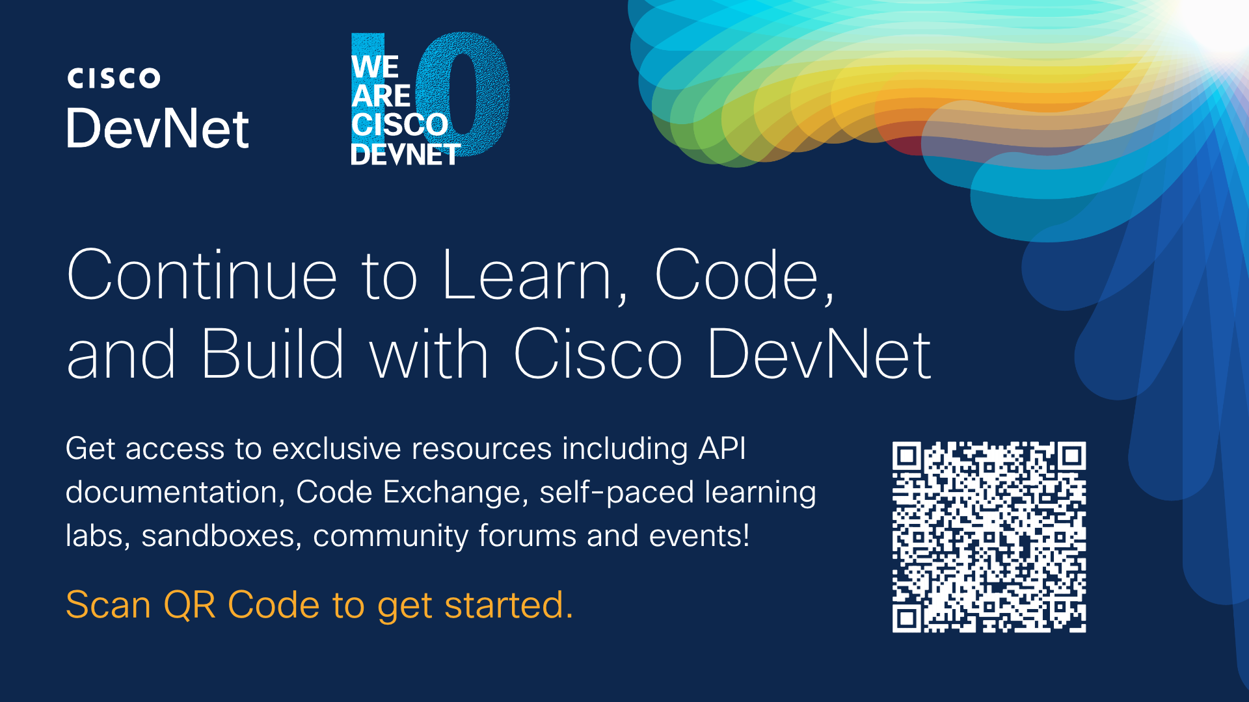
Cisco Code Exchange

